Slide 1
Software Process An Introduction
Dr Simon Lock
simon.lock@bristol.ac.uk

Slide 2
Slightly Weird Metaphor
Developing software is a bit like cooking...
chefs (developers)
follow a recipe (process)
to cook a meal for a hungry diner (client)

Slide 3
Slightly Weird Metaphor
Best chance of success is when you have:
Good chefs
Who can follow clearly defined recipes
Diners who make up their minds what to eat!

Slide 4
Important Points to Note
Good food can sometimes still be produced by experienced chefs even with a very poor recipe
We need to be careful not to be tricked into thinking that the recipe was a good one !
Even excellent recipes can be totally useless if your chefs aren't up to the job
Don't go thinking that because you have a good process, you can get away hiring just anybody

Slide 5
Types of Restaurant
Different restaurants run different types of kitchen
You won't expect a burger bar to cook in the same way has a high-end restaurant
Similarly, developers build in different ways for different products and markets
You won't expect fly-by-wire aircraft to be built in the same way as social media mobile apps !

Slide 6
Types of System
Stand-alone desktop applications
Transaction-based networked applications
Embedded control systems
Data collection and monitoring systems
Batch processing systems
Entertainment and education applications
Systems for modelling and simulation
etc…

Slide 7
“THE” Software Development Process
No such thing as "THE" software dev process
Different domains rely upon different processes
Different companies have own in-house standards
Similar concepts can have different names
Different experts advocate own way of working
All will try and convince you that theirs is the best !

Slide 8
Standardisation
There is limited (if any) agreement/standardisation
We’ll try to put across something coherent
Present some key concepts and processes
Might differ from what you do when you graduate
But majority of the fundamentals you will recognise

Slide 9
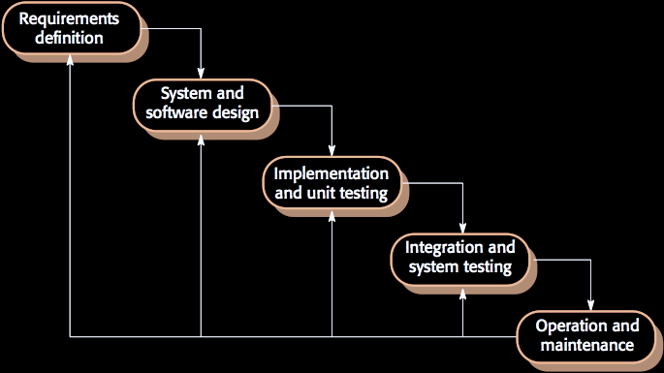
Waterfall Model

Slide 10
Realism
People dis waterfall model as naïve and unrealistic
But remember - it's a simplification & abstraction
A tool to help explain activities of SW development
Useful for undergrad Comp Sci courses !
It's not exactly what happens in the real world,
But it's a good start in trying to understand it

Slide 11
Waterfall versus Agile
You may have heard of Agile Development
Advocates of Agile often denigrate Waterfall
“It’s old fashioned & unrealistic” [see previous side]
Agile processes undertake all stages in parallel
Using short-burst sprints to deliver functionality
All stages at the same time ?
So you are eliciting requirements with one hand and writing code with the other ?

Slide 12
Key Development Activities

Slide 13
Requirements
What should the system do ?
What are the needs of the users ?
What are the needs of the host organisation ?
What are interoperability needs of existing systems
We need to think about functional elements
(stuff that system should do)
And also non-functional elements
(quality aspects of system operation)
Security, Reliability, Ease of Use, Maintainability etc.

Slide 14
Design
Before we implement anything, we need an overall structure for the system
What objects, architectures, files, databases, servers, services etc. should we create ?
Only then do we know the places where a requirement should be implemented
Also helps divide up work between team members

Slide 15
Implementation
You are familiar with programming, but there is more to implementation than just cutting code…
Parallel working and code sharing
API partitioning and “firewalling”
Versioning, integration and config management
Development environments and automated build
Docs and training material also need writing !

Slide 16
Verification & Validation
Demonstrates that system meets needs of client
Involves checking, reviewing, evaluating & testing
Testing is the most commonly used V & V activity
So you’ll be doing plenty of that !
User evaluation is the most undervalued
You’ll come up with excuses why you didn’t do it

Slide 17
Deployment
Once we have a working system…
We need to get it to the client
Could do it manually (send someone with a CD)
Or more modern automated “push” updates
Of particular interest is incremental delivery & continuous integration – more on these later !

Slide 18
What next ?
In later weeks we’ll consider these in more detail
Remember: waterfall model is a big simplification
But it's nice way of structuring content of this unit :o)

Slide 19
Tips for first client meeting
Get to know your main point of contact
Make sure you have their contact details
Find out what they think the business problem is
Listen politely to what they think solution should be
Try to identify the limits (“outer edge”) of solution
Arrange a demo of any existing systems
See if you can get a tour of their site or activities
Give client a feel for the release schedule
Make arrangements for the next meeting

Slide 20
Case Studies
All very well talking about theory of working with clients,
but reality of dealing with them is a different ballgame
It’s worth taking a look at how things work in real world,
illustrated with some examples from previous projects
It would be indelicate to mention the clients by name,
but you might be able to guess who they are ;o)

Slide 21
My Background
In parallel with academic work…
18 years developing interactive applications
for commercial, public sector and arts clients
Director of BigDog Interactive [2000-2011]
Technical Producer at Institute for Digital Art and Technology (i-DAT) [2011-2017]

